Slide 1
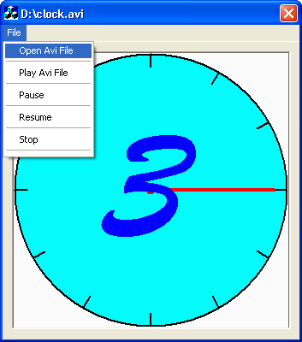
Playing AVI Files
By Ali Hussien

Slide 2
Implementation Details
Language : C++
Tool : Visual Studio 6 IDE
Application type : MFC-Dialog based

Slide 3
Details
This program plays “*.AVI” files by both MCISendCommands.
But playing video files is not as easy as playing audio files , as it needs three steps
  Opening the AVI file and let deviceID to be assigned automatically to the open parameter.
  Registering the Window that video file will displayed on.

Slide 4
  also video details can be retrieved such as video size ,so that we can adjust window size on it.
  The third step is playing the file using the simple MCISendCommand statement.

Slide 5
Displaying the Video
In a new window
  By assigning it’s Handel to the MCI_DGV_WINDOW_PARMS structure
In the current invoking window
  By passing this->m_hWnd to MCI_DGV_WINDOW_PARMS structure.

Slide 6
But I’ve used a picturebox (MFC CStatic
Control) to display the video on as it is inherted from CWnd Class so ,Sure it has a Handel.
CStatic* Border = (CStatic*) GetDlgItem(IDC_STATIC);
Pointer to Control
Casting The CWnd* OBJ
Control ID

Slide 7
Open &Play File
CStatic* Border = (CStatic*) GetDlgItem(IDC_STATIC);
Border->Invalidate(1);/*Damage the picture to allow it to be painted Once file playing finished*/
MCI_DGV_OPEN_PARMS Open; /*Define the open parameters struct store*/
Open.lpstrElementName =(char*)(LPCTSTR) m_FileName;
  // Set the filename.
Open.hWndParent = Border->m_hWnd; /*pass window handel*/

Slide 8
{
if (mciSendCommand(0, MCI_OPEN,
(DWORD)(MCI_OPEN_ELEMENT|MCI_DGV_OPEN_PARENT),
(DWORD)(LPSTR)&Open) == 0)
{
MCI_DGV_WINDOW_PARMS Window;
Window.hWnd = Border->m_hWnd;
mciSendCommand(Open.wDeviceID, MCI_WINDOW, MCI_DGV_WINDOW_HWND,(DWORD)(LPSTR)&Window);
MCI_DGV_PLAY_PARMS Play;
Play.dwFrom = 0;
mciSendCommand(Open.wDeviceID, MCI_PLAY, 0,(unsigned long )&Play);
}

Slide 9
Pausing Video
void CPlayVideoFilesDlg::OnFilePause()
{
UINT RetValue = mciSendCommand(DeviceID,MCI_PAUSE,0,NULL);
if(RetValue!=0)
{
MessageBox(GetError(RetValue));
}
}

Slide 10
Resuming Video
void CPlayVideoFilesDlg::OnFileResume()
{
UINT RetValue =mciSendCommand(DeviceID,MCI_RESUME,0,NULL);
if(RetValue!=0)
{
MessageBox(GetError(RetValue));
}
}

Slide 11
Stopping video
void CPlayVideoFilesDlg::OnFileStop()
{
UINT RetValue = mciSendCommand( DeviceID, MCI_STOP, 0,NULL);
if(RetValue!=0)
{
MessageBox(GetError(RetValue));
}
}

Slide 12
Getting Error
char * CPlayVideoFilesDlg::GetError(UINT mciError)
{
char * Errorstr = new char[600];
mciGetErrorString(mciError,Errorstr,600);
return Errorstr;
}

